Slide 1

Mini Project
Google Trends & Time Series Analysis
May 2018

Slide 2
1
AGENDA
Introduction to Google Trends
1
Understanding Time Series
2
Introduction to R Studio & Loading the Data
3
Exponential Smoothing & Holt-Winter Smoothing
4
ARIMA Modelling (step-by-step)
5
Student Project
6

Slide 3
Introduction to Google Trends What is Google?
What is Google?
Notes:
IN-CLASS PARTICIPATION

Slide 4

Introduction to Google Trends What is Google?

Slide 5
Introduction to Google Trends What is Google?
What is Google’s Mission Statement?
Notes:
IN-CLASS PARTICIPATION

Slide 6
Introduction to Google Trends What is Google?
“Organize the world’s information and make it universally accessible and useful.”

Slide 7
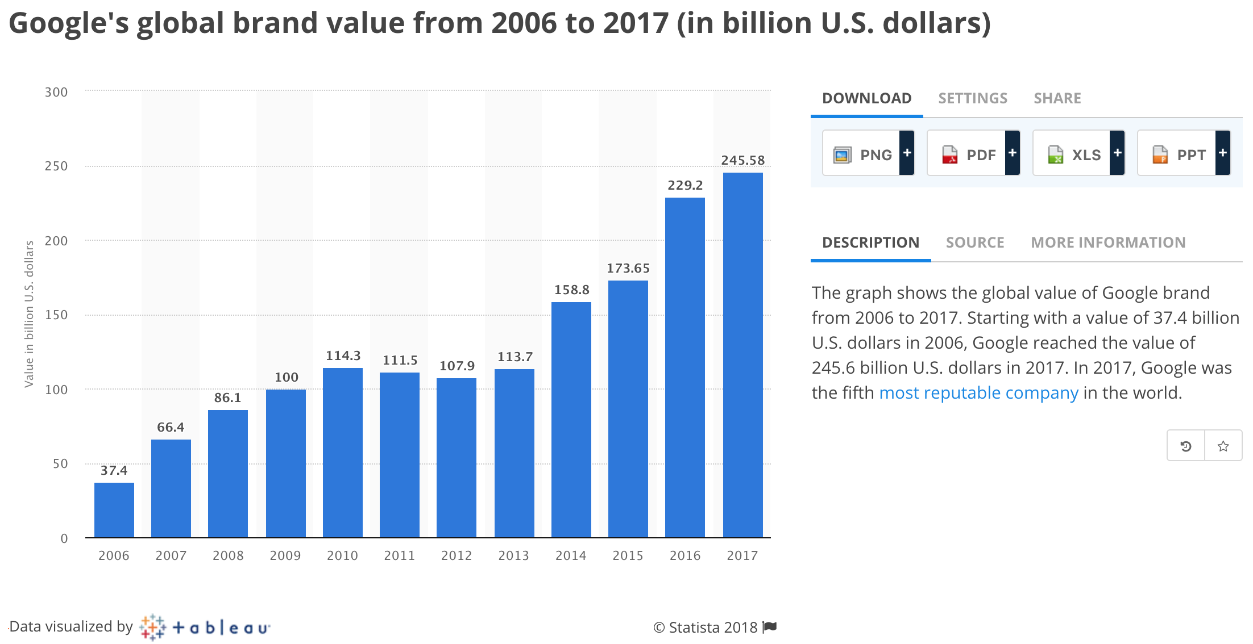
Introduction to Google Trends What is Google?
Notes:
Statista is a great resource for data, well-worth checking out if you have the time

Slide 8
Introduction to Google Trends What is Google?
What is Google Trends?
Notes:
IN-CLASS PARTICIPATION

Slide 9
Introduction to Google Trends What is Google?
Google Trends enables the user to see how often specific keywords, subjects or phrases have been queried over a specific period of time
Notes:
IN-CLASS PARTICIPATION

Slide 10
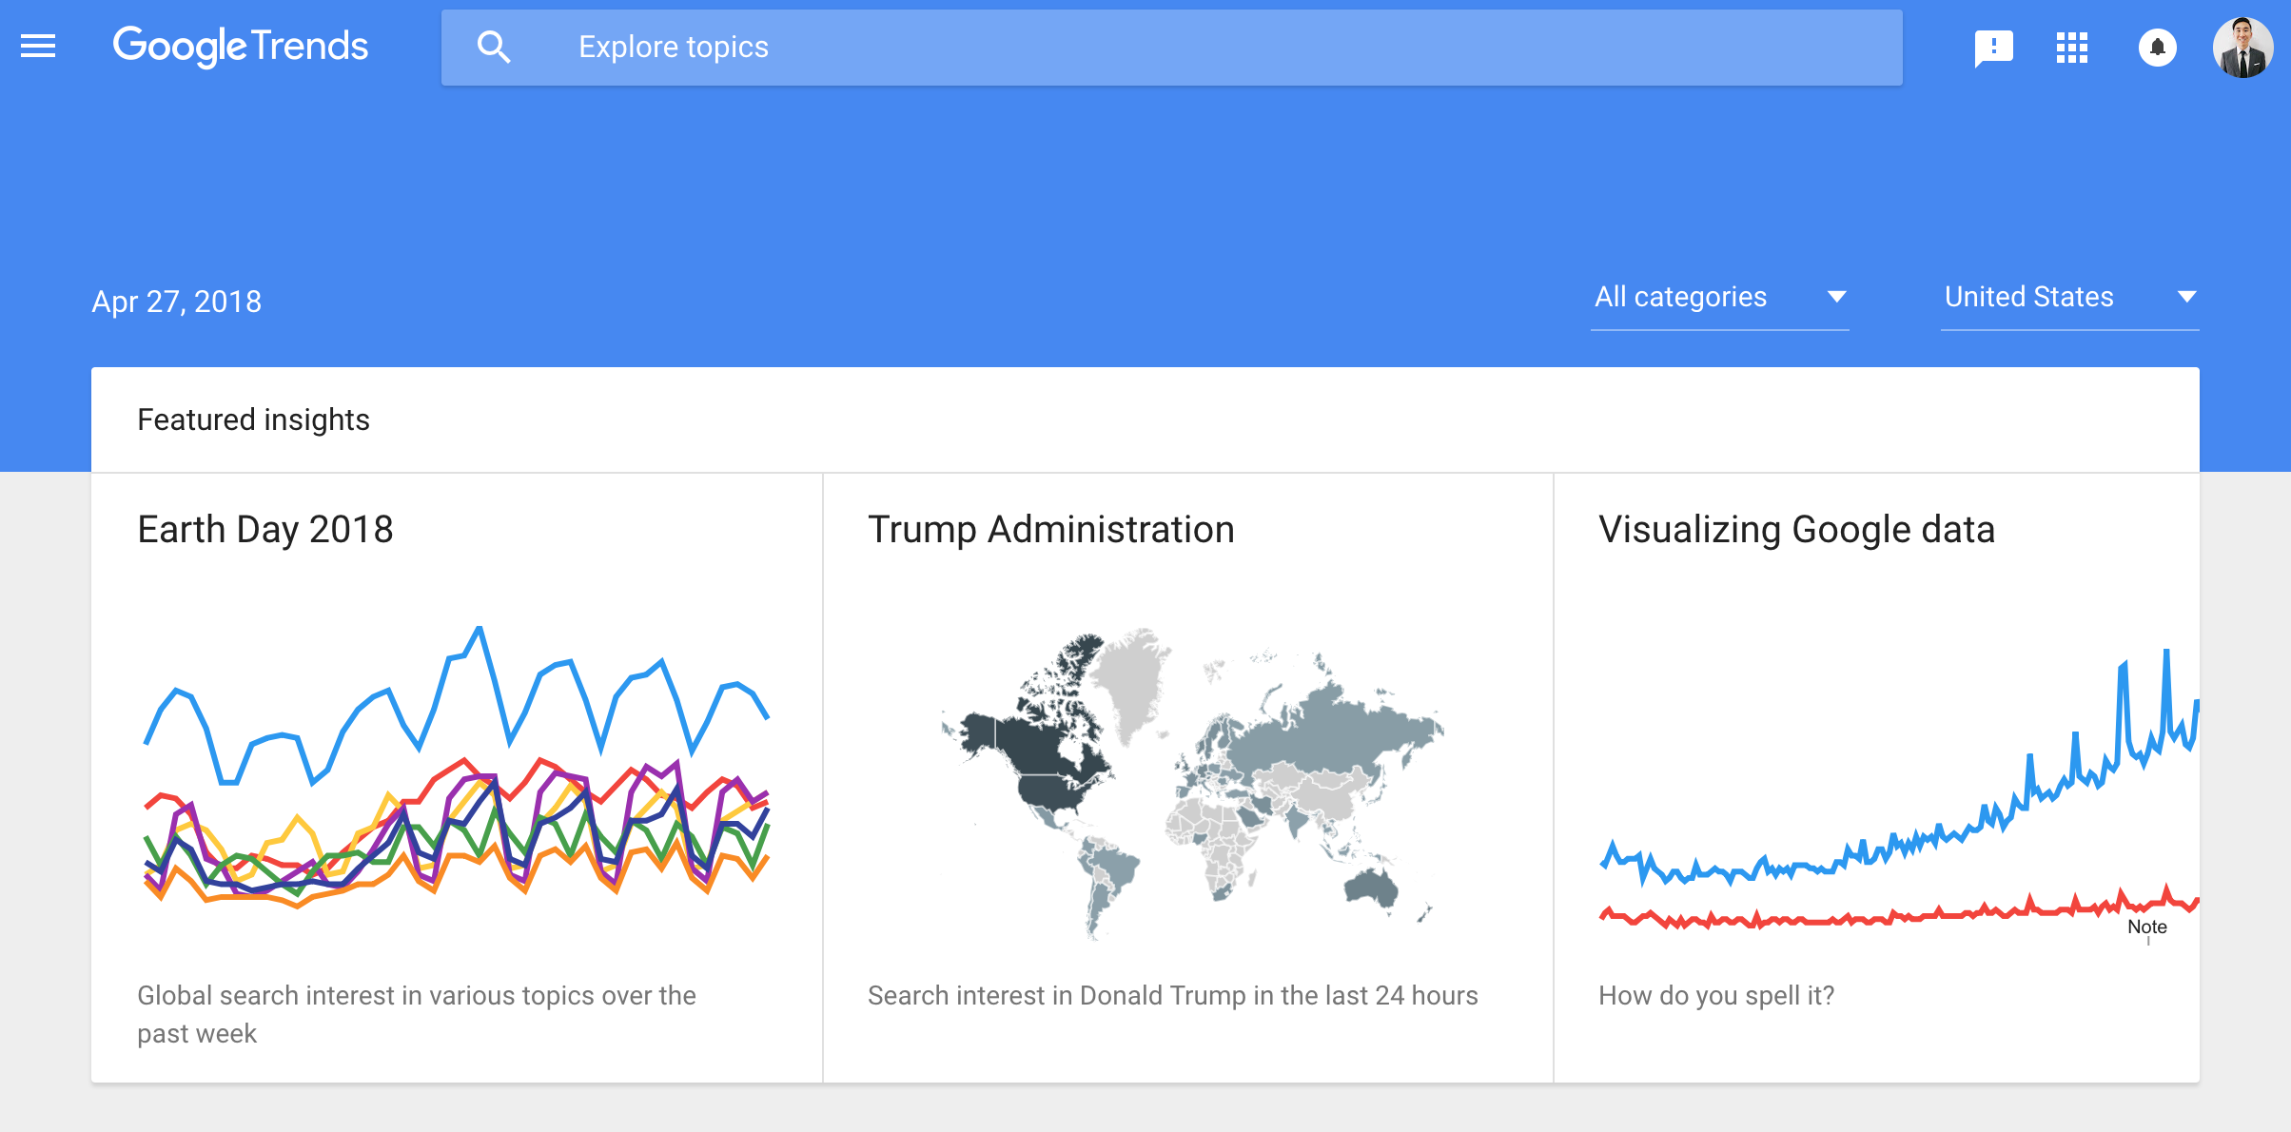
Introduction to Google Trends What is Google?
Notes:
The link is there, leave it open but I urge you to explore only after we have gone through the presentation. There will be plenty of time for that

Slide 11
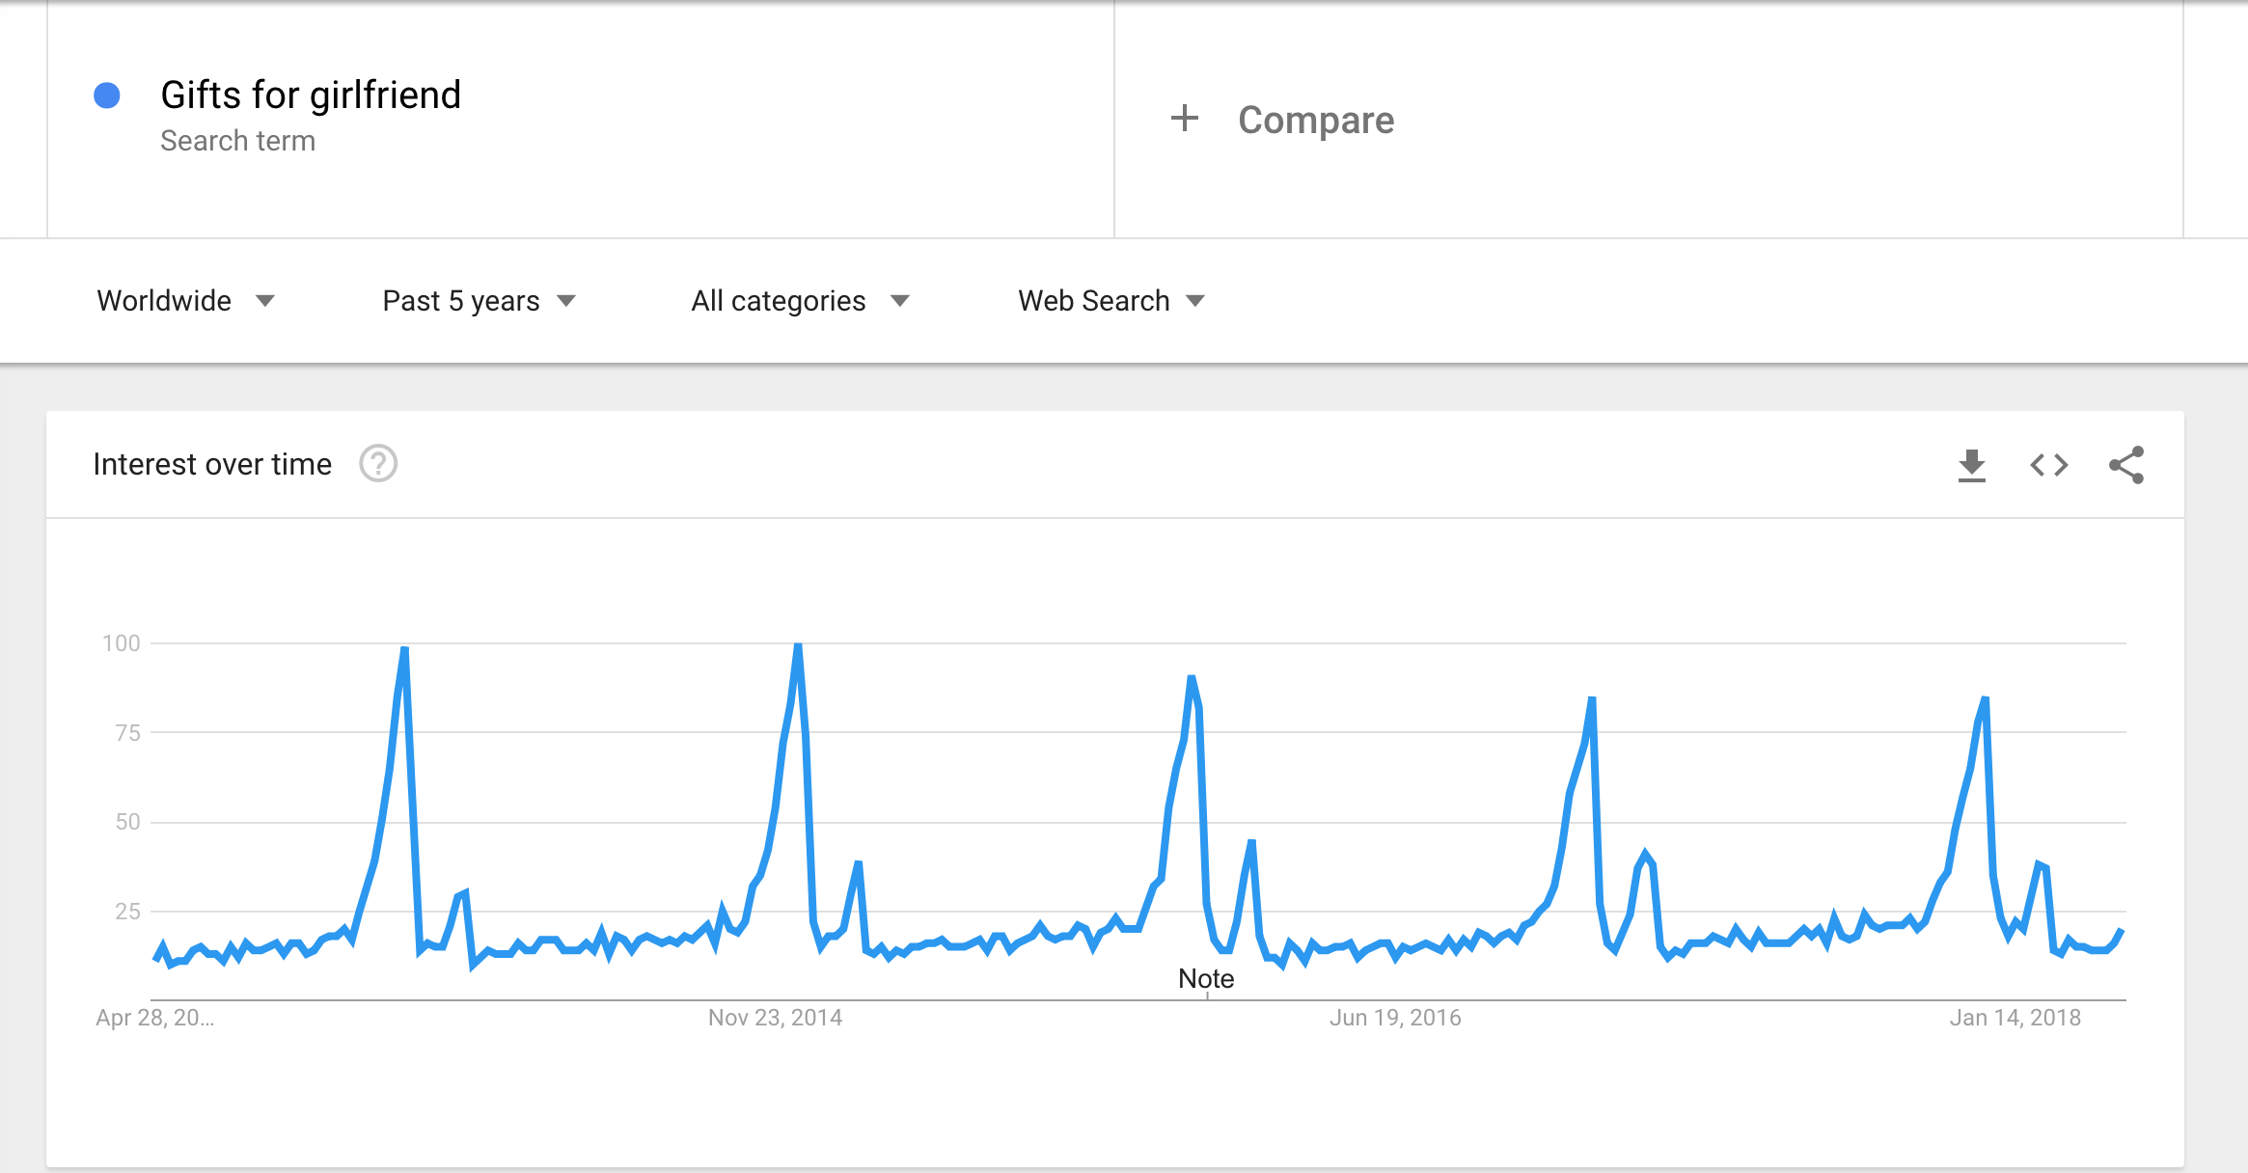
Introduction to Google Trends Our first trend - Why do we observe such a pattern forming?
Notes:
- Peaks are formed during December and February
- Any idea what is happening?

Slide 12
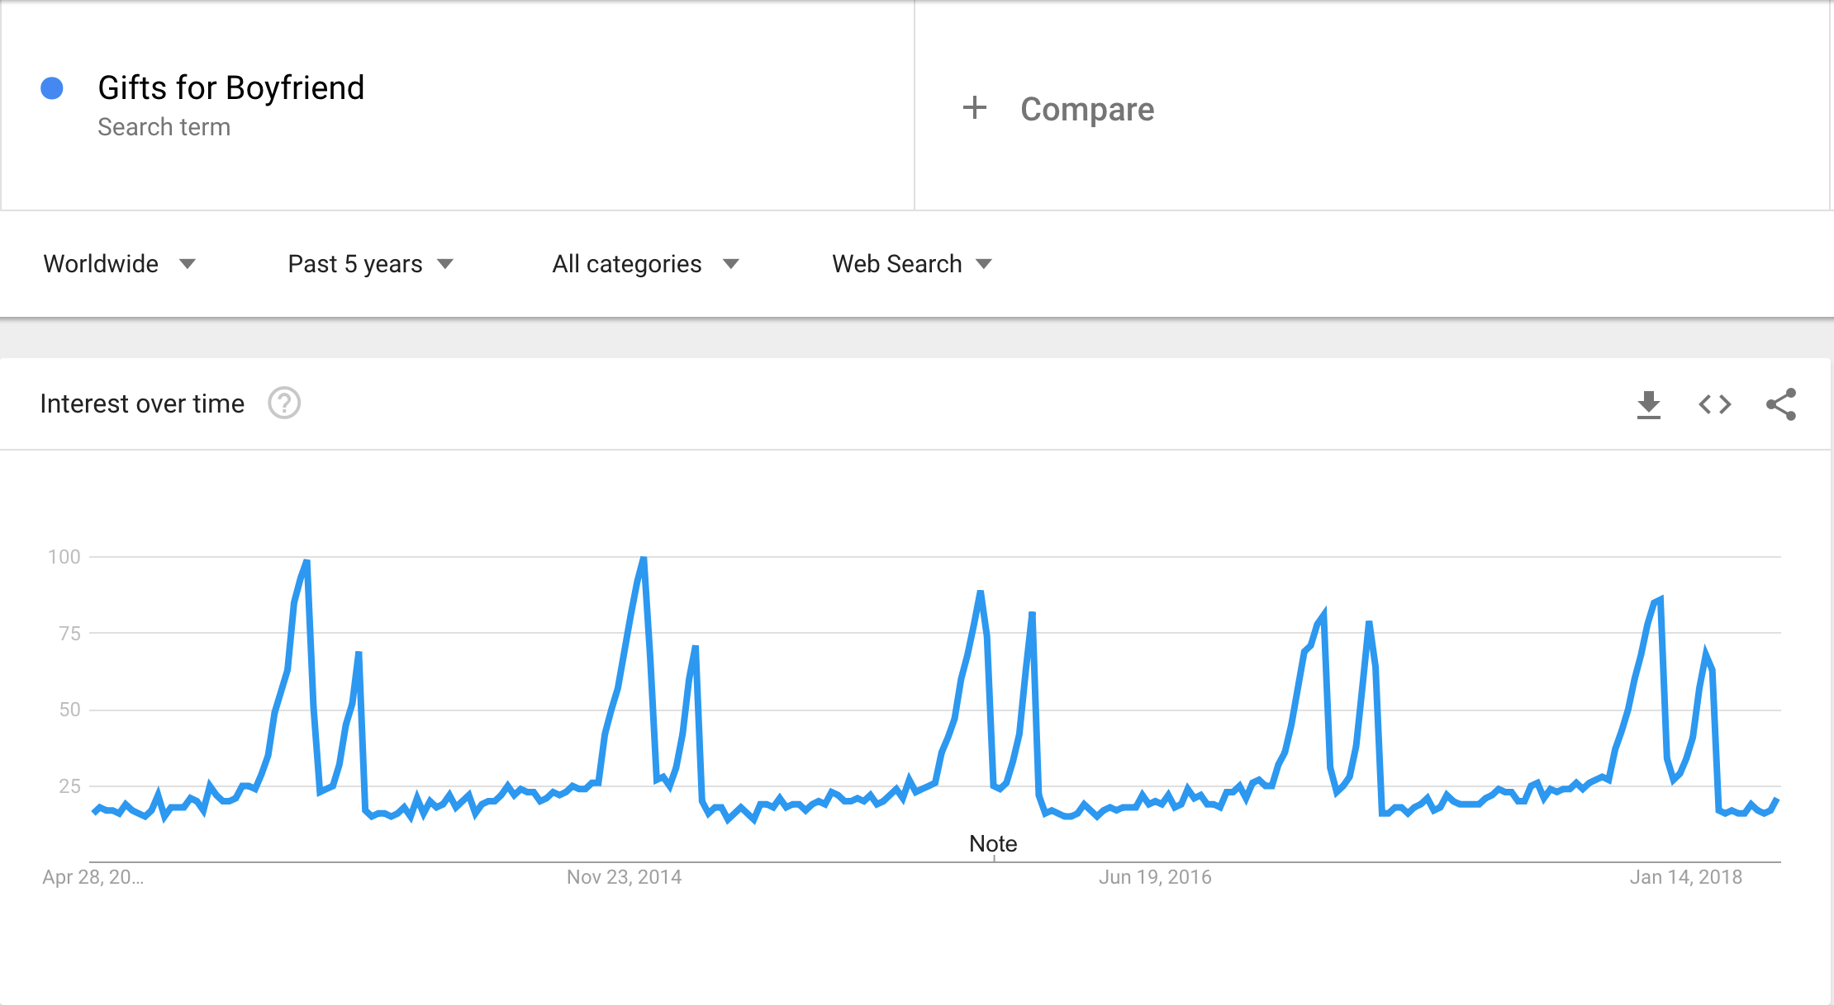
Introduction to Google Trends Compare this against the previous trend. What can we tell?

Slide 13
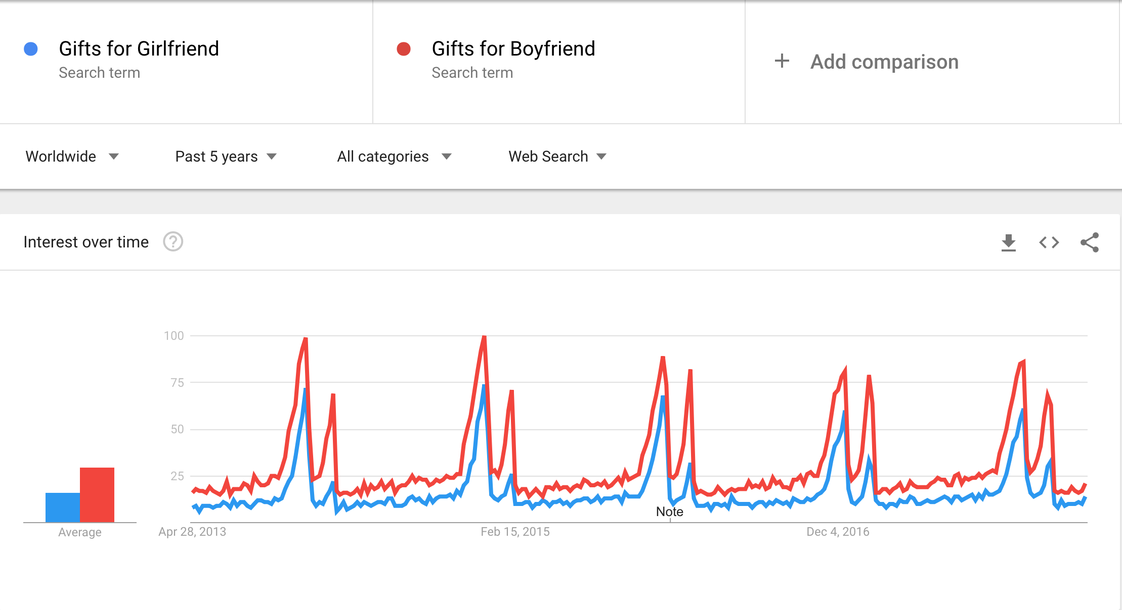
Introduction to Google Trends Comparing the trends, what insight can we gather?

Slide 14
Introduction to Google Trends What is Google?
In Google Trends, the Search Volume is indexed at 100
This scales data to capture the pattern without revealing the true search volume

Slide 15
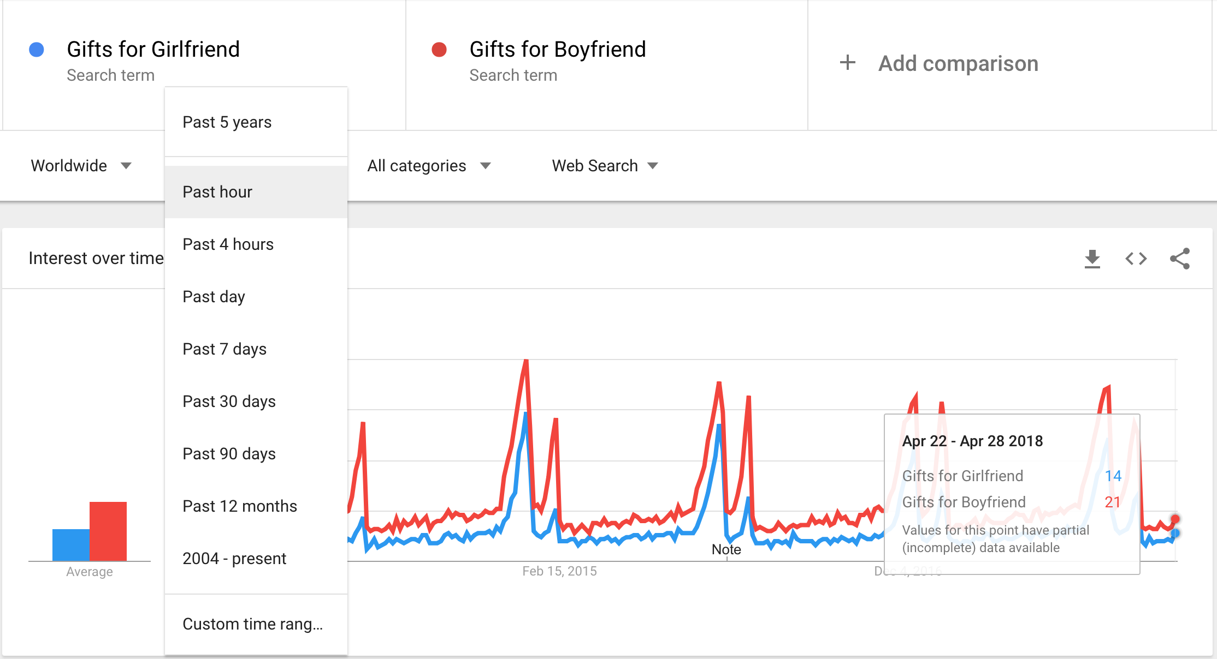
Introduction to Google Trends Adjusting your granularity
Notes:
The granularity of data available is dependent upon the popularity of your search term

Slide 16
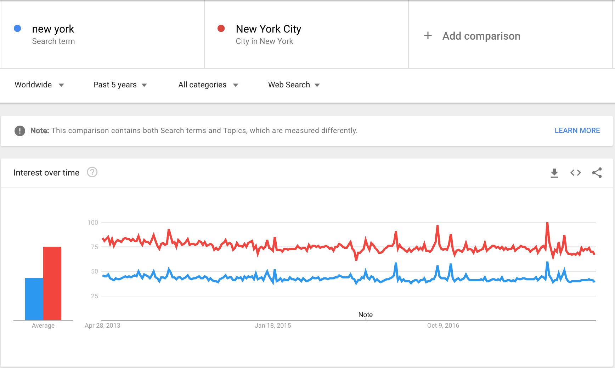
Introduction to Google Trends Difference between ‘Search Term’ and ‘Topic’
Notes:
These are compared differently. Wherever possible you want to ensure you are using search terms for both, or topics for both trendlines

Slide 17
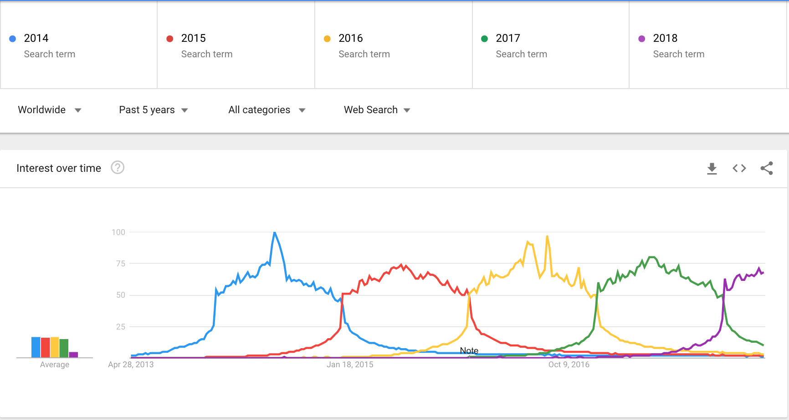
Introduction to Google Trends Comparison between different trend lines

Slide 18
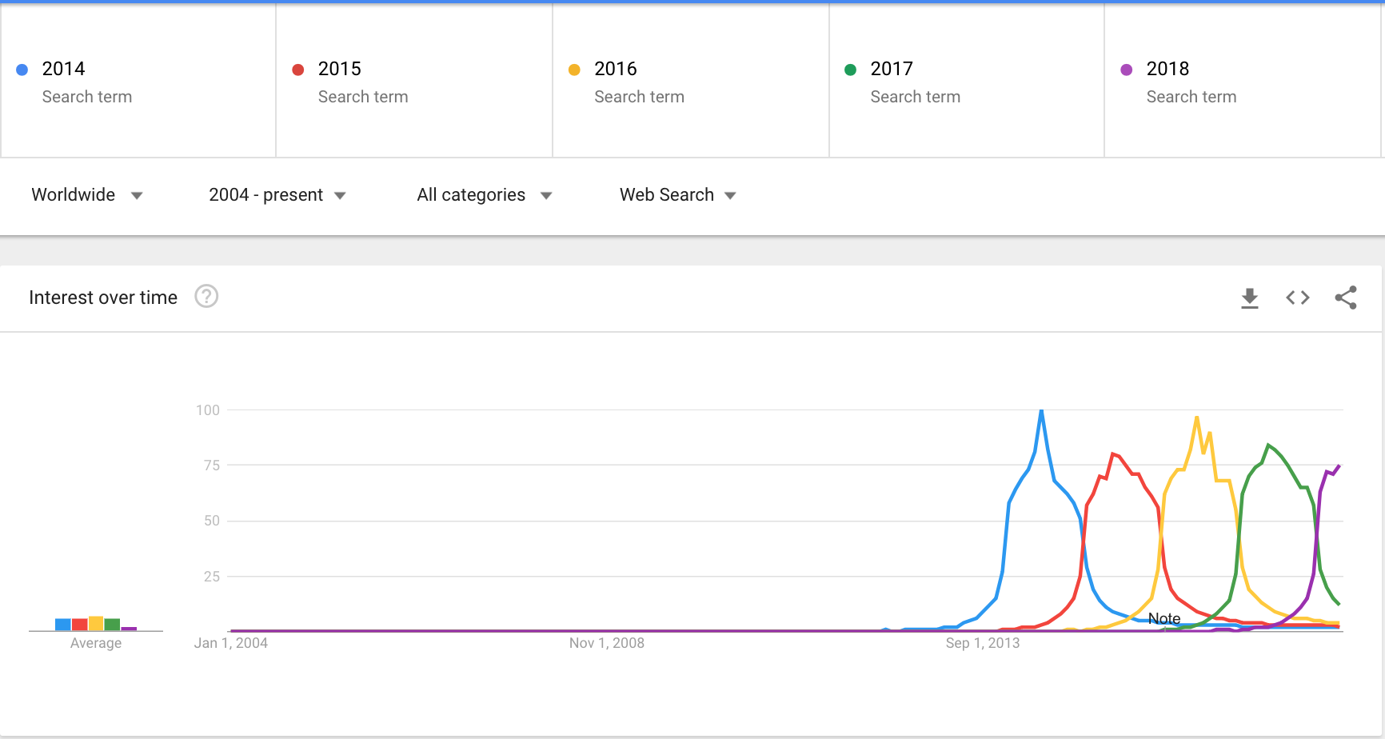
Introduction to Google Trends Comparison between different trend lines
Notes:
Google started publishing these trends in 2004. This is as far back as we an go in terms of data collection

Slide 19
Introduction to Google Trends Troubleshooting
What is a potential problem when using a ‘Search Term’ instead of a ‘Topic’?
Notes:
Search Terms are affected by language. Do you call it soda or soft drink? Tissue or Kleenex? Hoover or Vacuum Cleaner?

Slide 20


Introduction to Google Trends Interesting Examples presented by Google
Notes:
Click the links to open a new browser window

Slide 21
Understanding your time-series
Key concepts and terminology
Notes:
Take a 10 minute break

Slide 22
Understanding your Time-Series Key Concepts and Terminology
Why perform Time Series analysis?
Time series analysis is performed when we want to gain a deeper understanding of our data or when we want to perform forecasting on future values of our data
Notes:
Take a 10 minute break

Slide 23
Understanding your Time-Series Key Concepts and Terminology
Why perform Time Series analysis?
Financial and economic data are commonly analysed through the use of these techniques
Stock prices, Bitcoin prices, Housing prices, GDP, etc.
Notes:
Take a 10 minute break

Slide 24
Understanding your Time-Series Key Concepts and Terminology
Why perform Time Series analysis?
Performing a regression without taking into account time lags would fail to account for relationships through time, thus overestimating the relationship between dependent and independent variables
Notes:
Take a 10 minute break

Slide 25
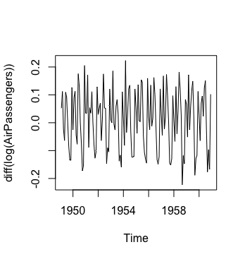
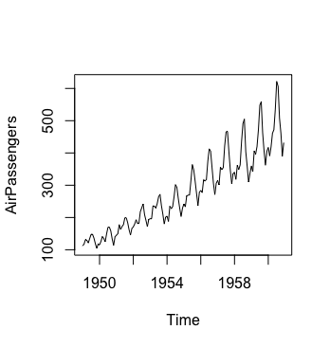
Understanding your Time-Series Key Concepts and Terminology
Homoscedasticity
Two subsets of your data will have similar levels of variance. Error term is more or less constant across all values of the independent variable
Heteroscedasticity
Variance of a variable is not constant; is unequal across the range of independent values
Figure: One common way to stabilize variance is to log transform. More on this later

Slide 26
Understanding your Time-Series Key Concepts and Terminology
Seasonality
Seasonality refers to periodic fluctuations in your data. Similar patterns should be observed when one period of the data is overlaid onto a future period of the data
Examples of seasonality include Christmas season sales, Winter sales of thick clothes, Summer sales of sunscreen
Figure: Our previous trends exhibit seasonality. Can you think of any other time series with seasonality?

Slide 27
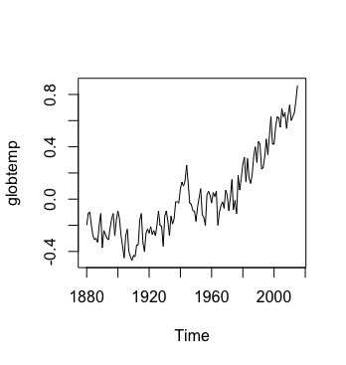
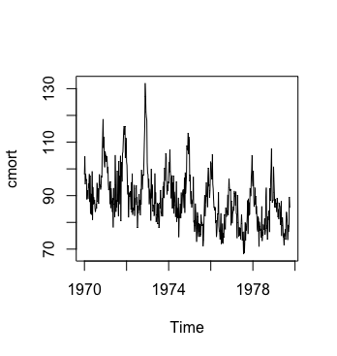
Understanding your Time-Series Key Concepts and Terminology
Trends
There are two forms of trends that may be present in your data. Time series data tends to have a positive trend, but this is not always the case.
Positive Trend
This tends to be more common in time-series analysis but it depends on the data
Global Temperate dataset (‘astsa’ package in R)
Downward Trend
Cardiovascular mortality dataset (‘astsa’ package in R)

Slide 28
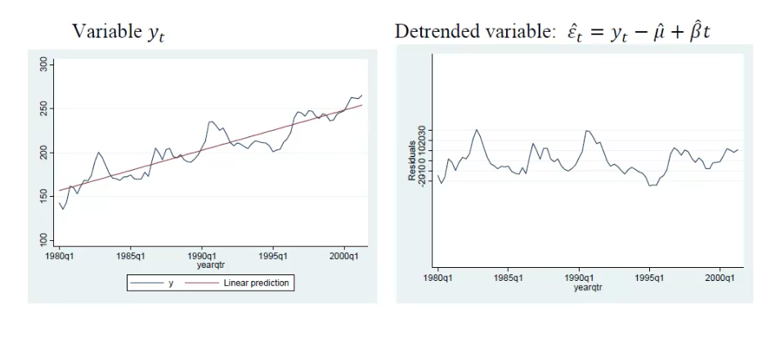
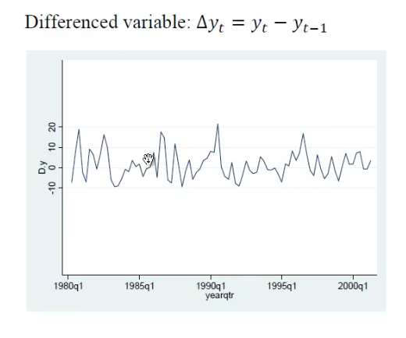
Understanding your Time-Series Key Concepts and Terminology
Detrending
You can detrend your data in many different ways. We will cover two of them in today’s lesson
Fit a linear regression and use the residuals from the line
Perform a regression on the time series data and take the residuals to the fitted line
Differencing
This is when you subtract the dependent variable from itself from a time lag away. This is the (I) in ARIMA

Slide 29
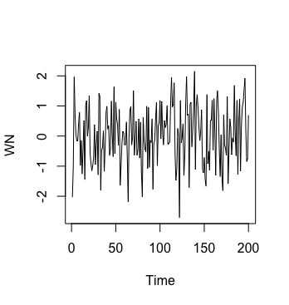
Understanding your Time-Series Key Concepts and terminology
White Noise
White noise is defined by having zero mean, constant variance and zero correlation (uncorrelated)
If your time series is pure white noise, it is random and you cannot reasonably create a model to make predictions
Forecast errors should ideally be white noise, as that means that all signal information in the time series has been harnessed by the model for prediction.

Slide 30
Understanding your Time-Series Key Concepts and terminology
You can test for stationarity with the Dickey Fuller test
Stationarity
For a process to be strictly stationary it must have all the following characteristics:
Mean of the series does not vary with time (constant)
Variance of the series does not vary with time (constant) a.k.a homoscedasticity
Covariance of the i^{th} and i^{th} + m term does not vary with time (constant)
There should not be a trend present
*Weak stationarity only requires these
Figure: White Noise exhibits stationarity as it has zero mean, a constant variance and there is no trend
Notes:
Y_{t} = alpha + Beta X_{t} + error_{t} <- This is a linear model. if you want a linear relationship between Y and x all other variables should be constant Null hypothesis is that your time series is non-stationarity
If rho is < 1, your time series is stationary

Slide 31
Time Series Analysis with R
Code-along session

Slide 32
Time Series Analysis with R Code-along session
Agenda
Getting Familiar with R Studio
Downloading your Data
Loading your data into R Studio
Performing Exploratory Data Analysis
Notes:
IN-CLASS PARTICIPATION

Slide 33
Getting Familiar with R Studio
Time Series Analysis with R Code-along session
Hop on over to your R Studio. Lets tour the IDE together and see what it can do

Slide 34
Time Series Analysis with R Code-along session
Key Takeaways
R Studio is a powerful Integrated Development Environment (IDE) for R
For the purposes of statistical analysis such as today’s time series analysis, R is slightly more intuitive and quicker than Python
Notes:
Takeaways from R Studio Tour

Slide 35
Exploratory Data Analysis
Time Series Analysis with R Code-along session

Slide 36
Time Series Analysis with R Code-along session
Key Questions
What is the granularity of your data?
Is there seasonality in your data?
How many observations do you have in your data?
Notes:
Open the CSV file here through a live demo to show the audience what the file looks like

Slide 37
Time Series Forecasting

Slide 38
Time Series Forecasting
Downloading Information
Visualising Data
Forecasting with our Data
Exponential Smoothing
ARIMA modelling
Holt-Winters Triple Smoothing
(accounts for seasonality & trend)
Stationarise our time series
Fit the ARIMA(p,d,q) model
Make predictions
Make predictions

Slide 39
Forecasting with Exponential Smoothing
Exponential Smoothing & Holt-Winters Triple Exponential Smoothing

Slide 40
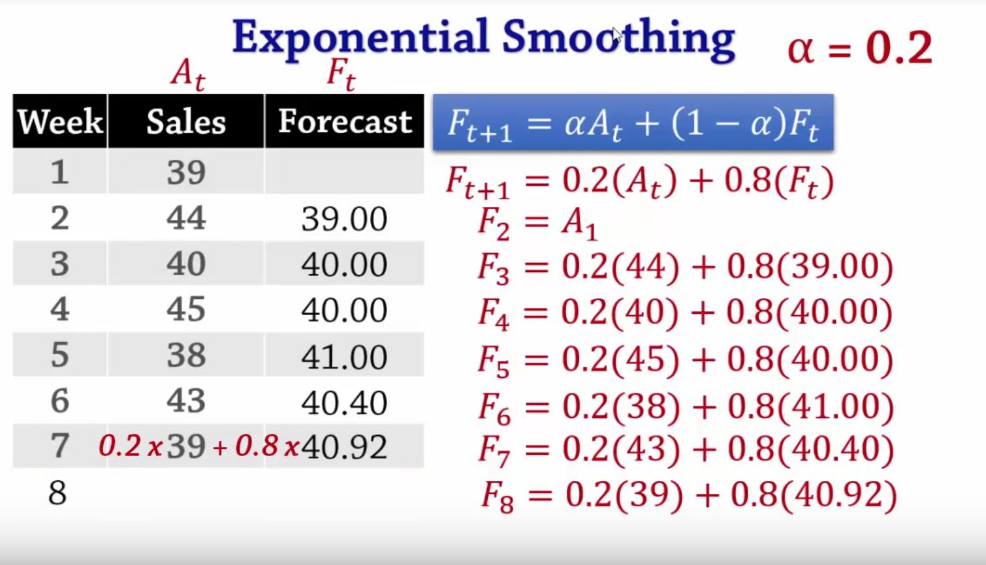
Time Series Forecasting Exponential Smoothing & Holt-Winters Triple Smoothing
Exponential Smoothing
(Weighted moving average)
Exponential Smoothing is done to make short-term forecasts for time series data. It uses a weighted moving average
Formula:
Forecast_{t+1} = ⍺Actual_{t} + (1 - ⍺) Forecast_{t}
⍺ is known as a smoothing constant, it takes a value between 0 and 1
It dictates how much ‘weight’ we give the most recent observed value versus the last expected
More weight to the left as you approach 1
Finding the best ⍺ is done by trial and error (a process known as ’fitting’)
Figure: Click on the image to view the source video

Slide 41
What happens when we have seasonality and trends present in our data? Will exponential smoothing capture that in a forecast?
Notes:
Will exponential smoothing capture that in a forecast?

Slide 42
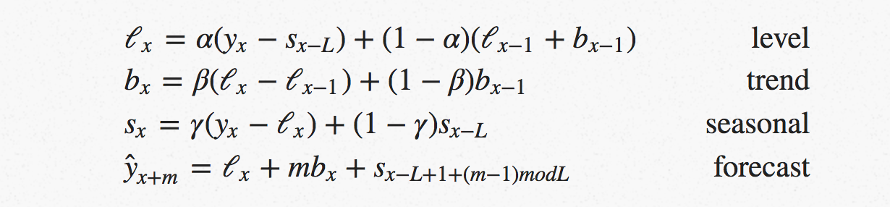
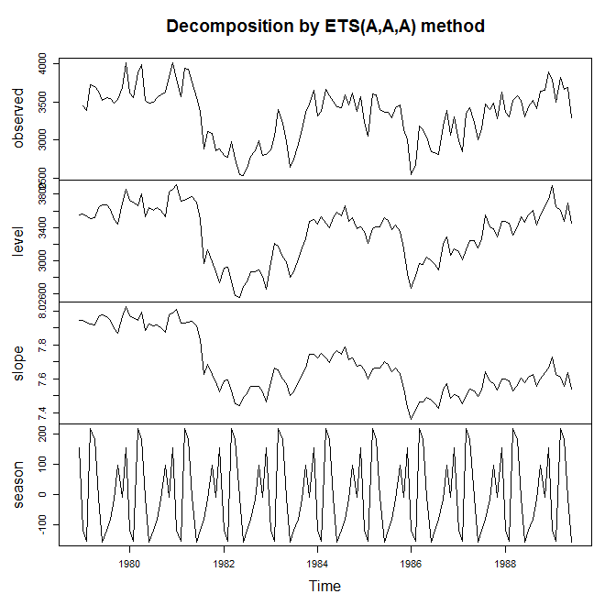
Time Series Forecasting Exponential Smoothing & Holt-Winters Triple Smoothing
Holt-Winters Triple Smoothing
Holt-Winters smoothing applies smoothing to the seasonal, trend and level components.
It takes three different smoothing constants:
Ɣ – Gamma is the smoothing factor for the seasonal component
β – Beta is the smoothing factor for the trend component
⍺ - Alpha is the smoothing factor for the level component
Figure: Four mathematical equations

Slide 43
Forecasting with ARIMA (p,d,q) Models
A quick introduction to ARIMA models

Slide 44
Time Series Forecasting
Downloading Information
Visualising Data
Forecasting with our Data
Exponential Smoothing
ARIMA modelling
Holt-Winters Triple Smoothing
(accounts for seasonality & trend)
Stationarise our time series
Fit the ARIMA(p,d,q) model
Make predictions
Make predictions

Slide 45
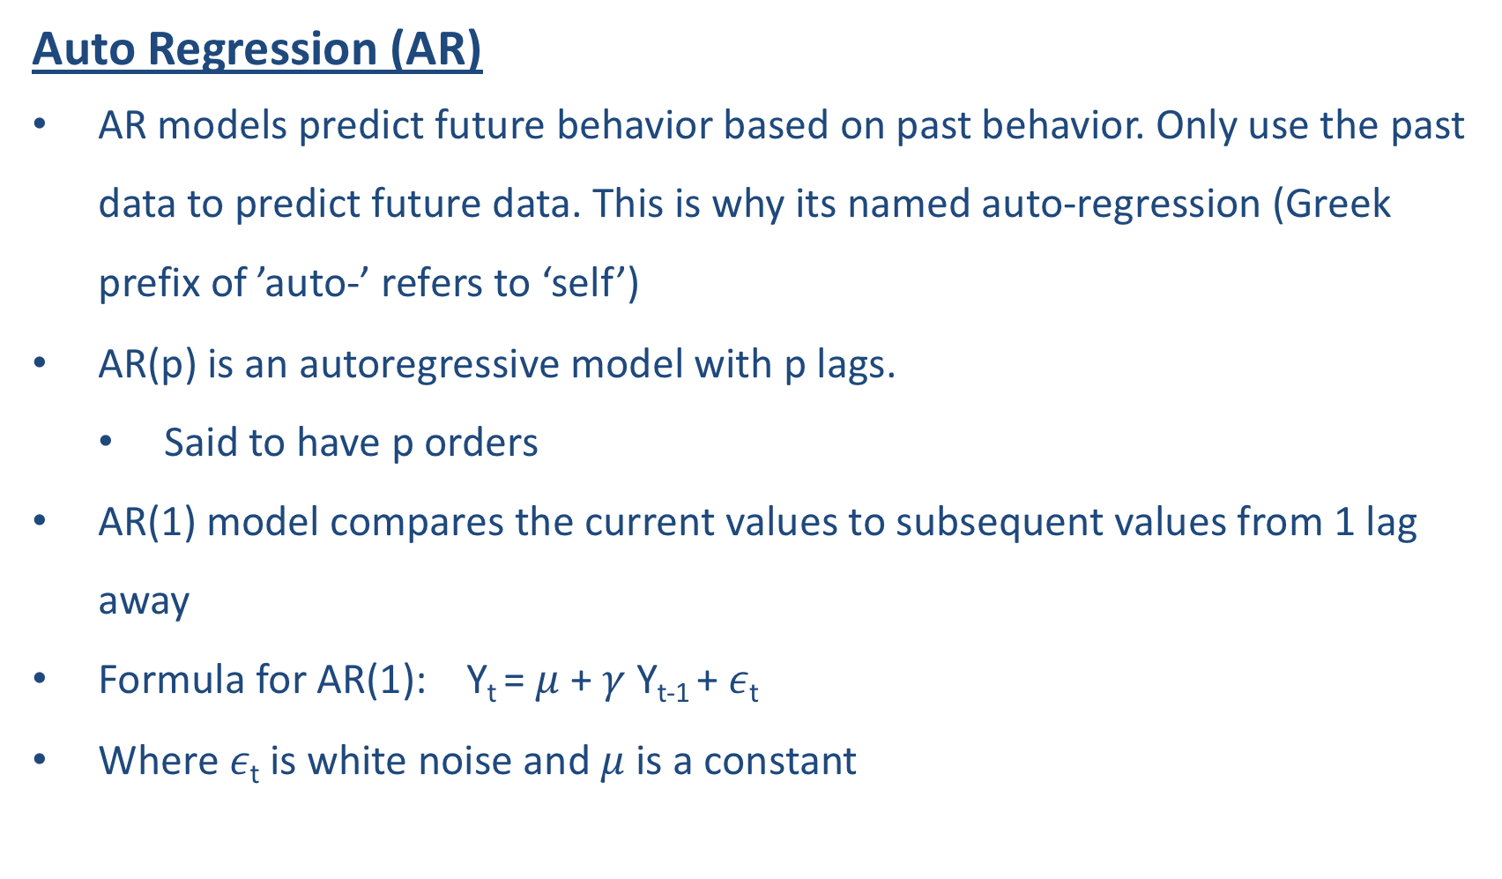
ARIMA Modelling AutoRegressive Integrated Moving Average
Auto Regression (AR)
AR models predict future behavior based on past behavior. Only use the past data to predict future data. This is why its named auto-regression (Greek prefix of ’auto-’ refers to ‘self’)
AR(p) is an autoregressive model with p lags.
Said to have p orders
AR(1) model compares the current values to subsequent values from 1 lag away
Formula for AR(1): Y_{t} = $μ$ + $γ$ Y_{t-1} + $ε\text{t}$
Where $ε\text{t}$ is white noise and $μ$ is a constant
Notes:
$μ$ constant is sometimes subbed in as 0 and ignored
Draw tabular data to show the lags

Slide 46
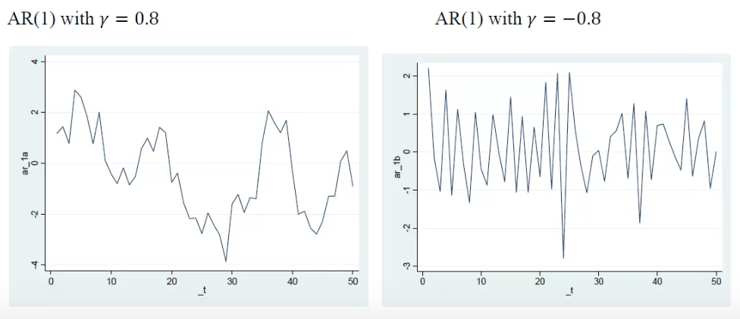
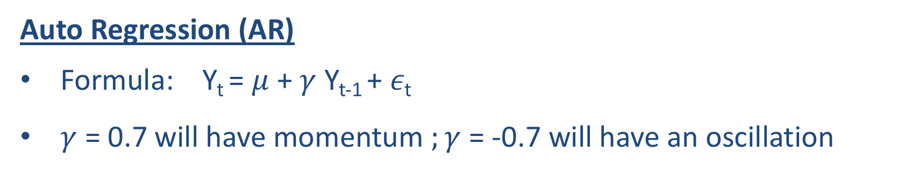
ARIMA Modelling AutoRegressive Integrated Moving Average
Auto Regression (AR)
Formula: Y_{t} = $μ$ + $γ$ Y_{t-1} + $ε\text{t}$
$γ$ = 0.7 will have momentum $;γ$ = -0.7 will have an oscillation

Slide 47
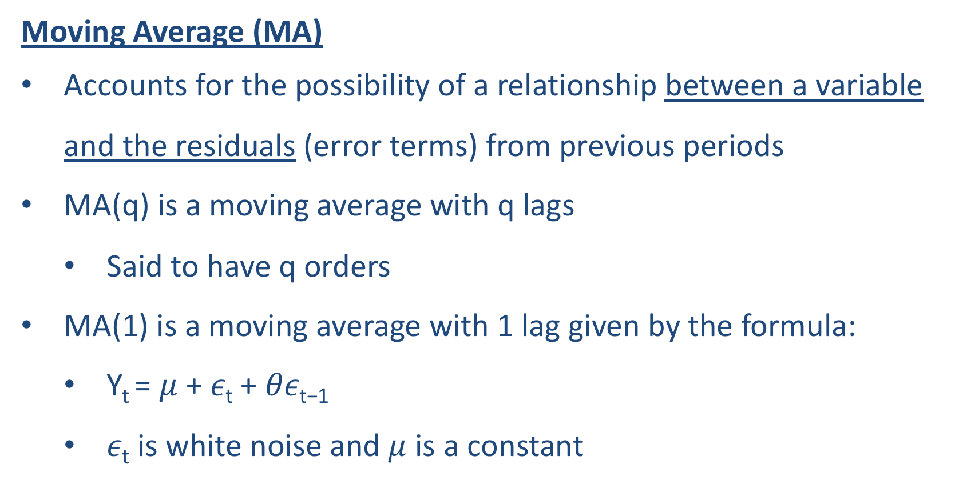
ARIMA Modelling AutoRegressive Integrated Moving Average
Moving Average (MA)
Accounts for the possibility of a relationship between a variable and the residuals (error terms) from previous periods
MA(q) is a moving average with q lags
Said to have q orders
MA(1) is a moving average with 1 lag given by the formula:
Y_{t} = $μ$ + $ε\text{t}$ + $θε\text{t}\text{−1}$
$ε\text{t}$ is white noise and $μ$ is a constant

Slide 48
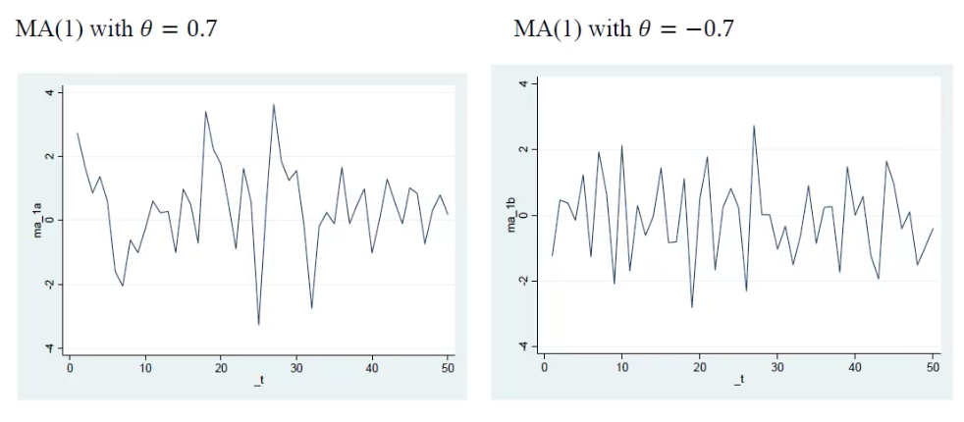
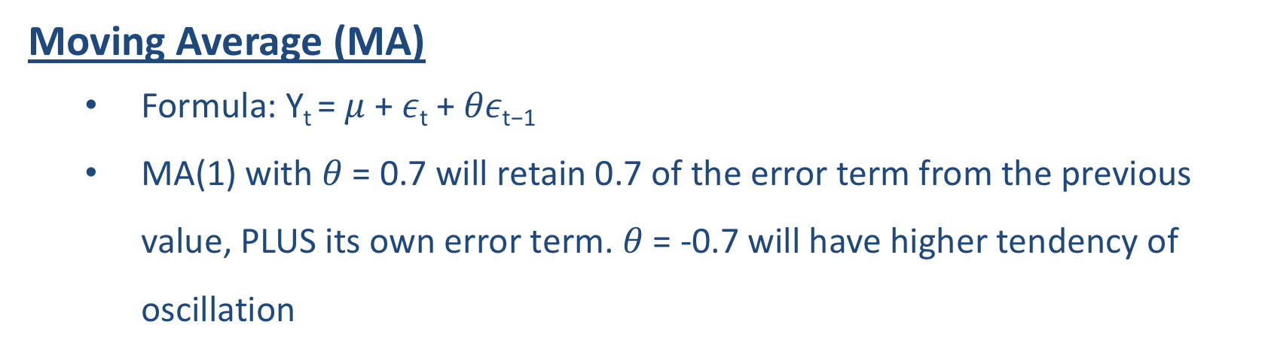
ARIMA Modelling AutoRegressive Integrated Moving Average
Moving Average (MA)
Formula: Y_{t} = $μ$ + $ε\text{t}$ + $θε\text{t}\text{−1}$
MA(1) with $θ$ = 0.7 will retain 0.7 of the error term from the previous value, PLUS its own error term. $θ$ = -0.7 will have higher tendency of oscillation

Slide 49
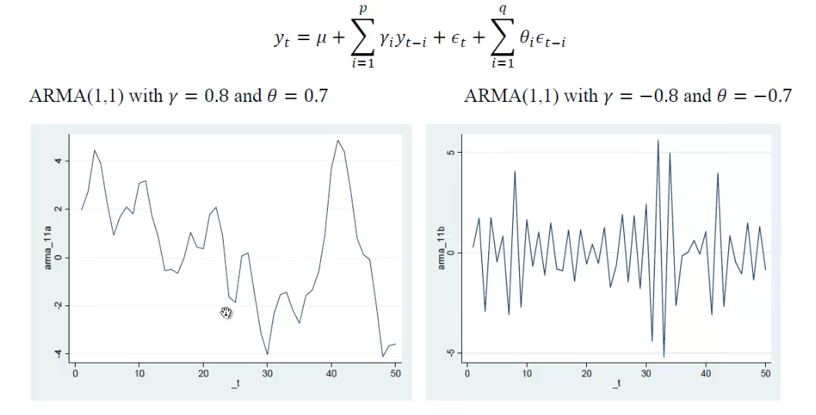
ARIMA Modelling AutoRegressive Integrated Moving Average
Autoregressive Moving Average (ARMA) (p,q)
Combines both p autoregressive terms and q moving average terms

Slide 50
ARIMA Modelling AutoRegressive Integrated Moving Average
Difference between AR and MA models
AR compares current values of variable with past values
MA compares the error terms of past data to predict current values

Slide 51
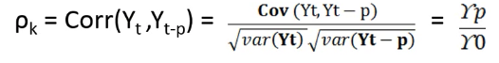
ARIMA Modelling AutoRegressive Integrated Moving Average
Auto Correlation Function (ACF) & Partial Auto Correlation Function (PACF)
ACF gives the gross correlation between y_{t} and y_{t-k}
PACF gives the simple correlation between y_{t} and y_{t-k} MINUS the part of the correlation explained by the intervening lags
Y₅, Y_{4,} Y_{3,} Y_{2,} Y₁ == ACF ; Y₅, Y₁ == PACF

Slide 52
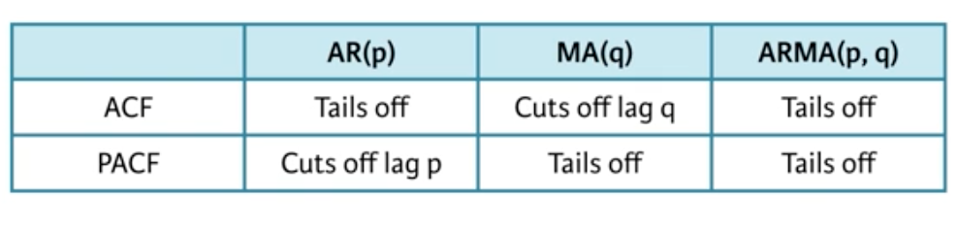
ARIMA Modelling AutoRegressive Integrated Moving Average
Auto Correlation Function (ACF) & Partial Auto Correlation Function (PACF)
Sample plots of ACF and PACF provide us with an estimate of the appropriate values of p,q we will use in the ARIMA model
We will use a special plot known as a ‘correlogram’ which simple plots the sample ACF on the y-axis and lags on the x-axis

Slide 53
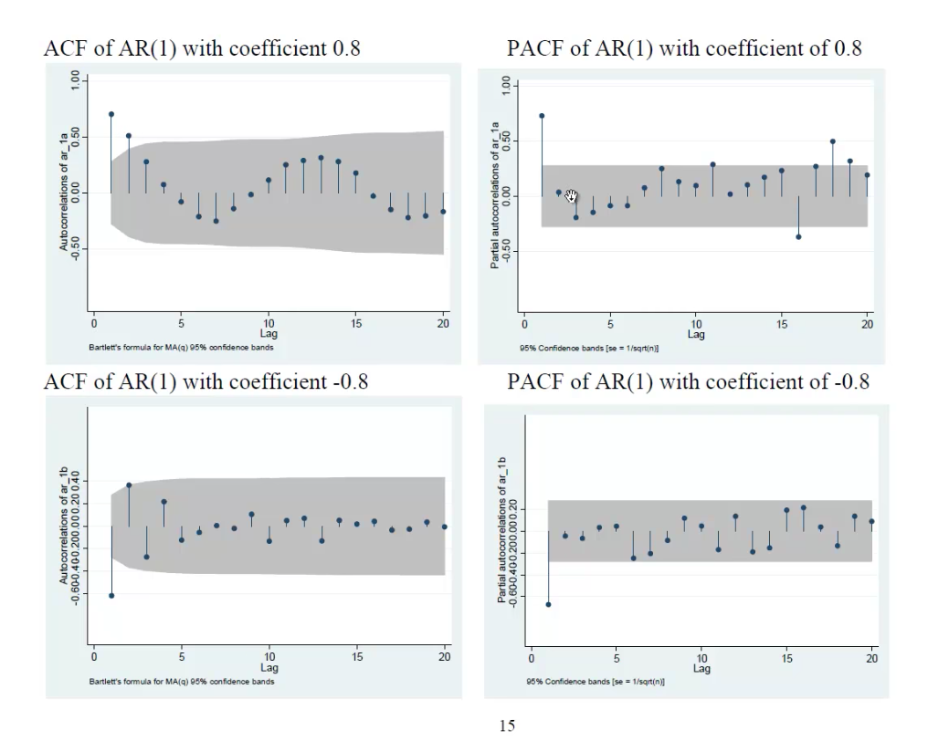
ARIMA Modelling AutoRegressive Integrated Moving Average

Slide 54
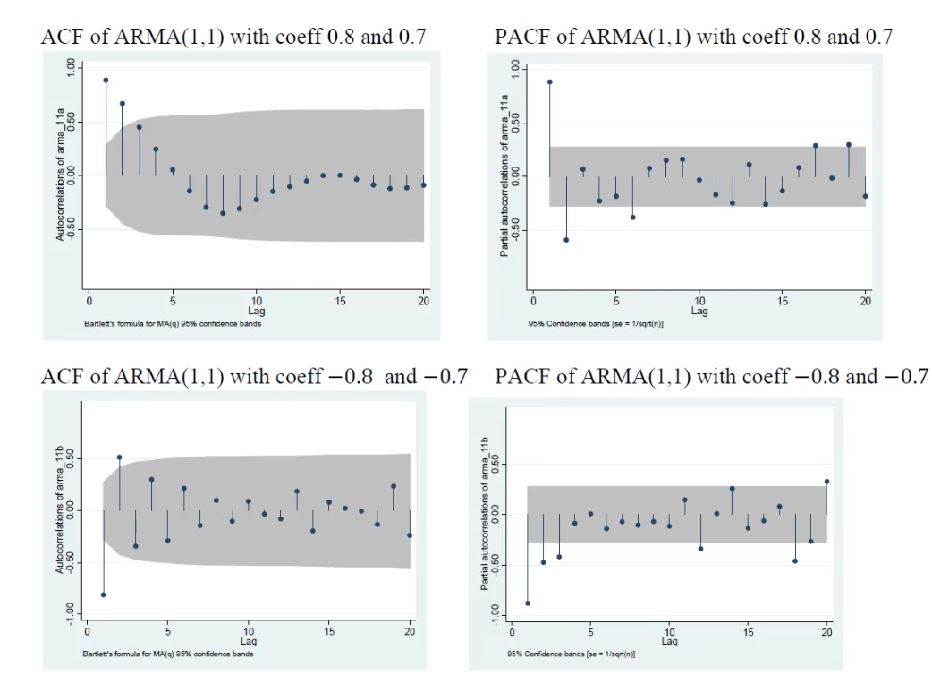
ARIMA Modelling AutoRegressive Integrated Moving Average

Slide 55
ARIMA Modelling AutoRegressive Integrated Moving Average
Evaluation of your ARIMA model (not covered)
You want to choose models with the lowest value of Akaike Information Criterion (AIC) / Bayesian Information Criterion (BIC)

Slide 56
Student Project
Design your own time series analysis by collecting data, analyzing it and performing some form of forecasting

Slide 57
Student Project Time Series Analysis with R
Time Series Analysis Workflow
0.5 Download data & Load it
Visualise the time series
Stationarise the time series
Plot ACF/PACF charts and find the optimal parameters (p,1,q)
Fit the ARIMA model
Make Predictions
Also do a Holt-Winters Exponential Smoothing
3-minute presentation (Randomly selected) 5 people (3:45pm)

Slide 58
Student Project Time Series Analysis with R
Submit your R scripts
by the end of class via e-mail to your representatives who will then forward to me

